Slide 1







Analysis of Technology Trends Using IBM Cognos Dashboard
AFFAN AKHTER
29-07-24

Slide 2



OUTLINE
Executive Summary
Introduction
Methodology
Results
Visualization – Charts
Dashboard
Discussion
Findings & Implications
Conclusion
Appendix

Slide 3

EXECUTIVE SUMMARY
Data Analyzed: Current and future tech trends from IBM Cognos dashboard.
Key Trends:
Databases: Top current and desired.
Platforms: Popular now and in future.
Languages & Frameworks: Current and next year trends.
Demographics: Insights by gender, age, country, and education.
Future Trends: Predictions based on data.
Implications: Impact on tech adoption and skills demand.

Slide 4

INTRODUCTION
This project analyzes current and future technology trends using IBM Cognos dashboards.
Objectives: identify popular databases, programming languages, and web frameworks; predict future trends.
Understanding these trends helps businesses stay competitive and professionals align their skills.
The project addresses rapidly changing technology landscapes and the need for up-to-date insights.
Data is sourced from job postings and technology usage surveys.
Previous research on technology adoption and market trends informs the methodology.

Slide 5

METHODOLOGY
Data Collection: Aggregate relevant data from various sources, including internal databases and external surveys.
Data Cleaning: Process and clean the collected data to ensure accuracy and consistency.
Data Analysis: Use statistical and analytical tools to examine trends and patterns in the data.
Visualization: Create dashboards and charts using IBM Cognos to present the findings clearly.
Tools Used: Utilize IBM Cognos, Excel, and Python for data processing and analysis.
Validation: Cross-check findings with secondary sources to validate the results.

Slide 6

RESULTS
Top Databases: Identified the most widely used databases, including MySQL, PostgreSQL, and MongoDB.
Programming Languages: Determined the leading programming languages, with JavaScript, Python, and Java ranking highest.
Web Frameworks: Found that React.js, Angular, and ASP.NET are the top web frameworks currently in use.
Future Trends: Predicted an increase in demand for technologies such as Kubernetes, TypeScript, and PostgreSQL in the coming year.
Demographics: Analyzed the demographic distribution of survey respondents by age, gender, and education level.
Visualizations: Presented the findings through various dashboards and charts created in IBM Cognos.

Slide 7
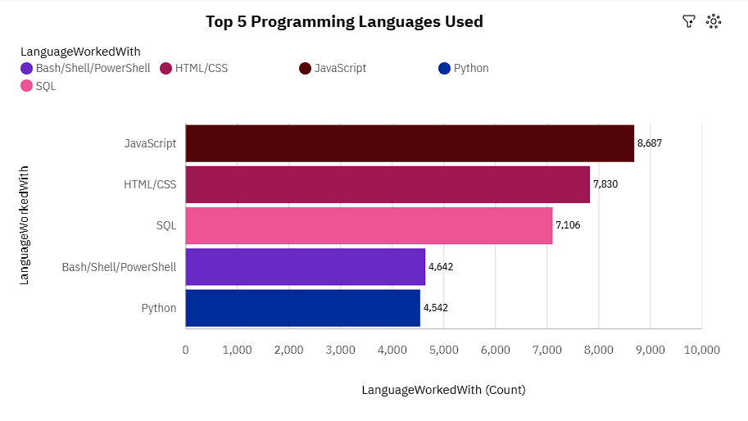
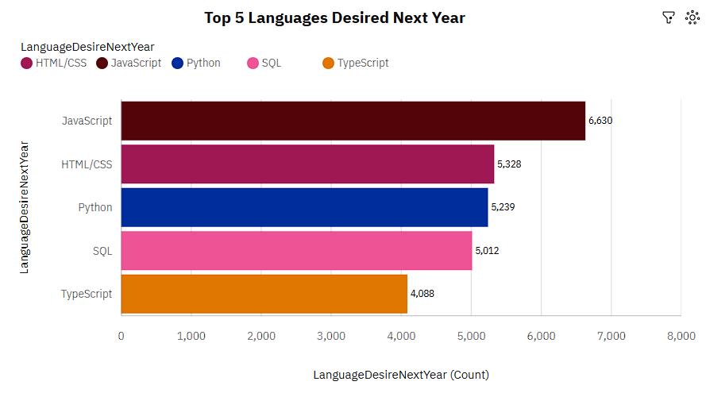
PROGRAMMING LANGUAGE TRENDS
Current Year
Next Year

Slide 8
PROGRAMMING LANGUAGE TRENDS - FINDINGS & IMPLICATIONS
Findings
JavaScript is the most desired language for the next year (6,830 count).
Python is highly popular in both current usage (7,106) and future interest (5,239).
TypeScript shows significant future interest (4,068) despite lower current usage (2,232).

Slide 9
PROGRAMMING LANGUAGE TRENDS - FINDINGS & IMPLICATIONS
Implications
Increased demand for JavaScript and TypeScript skills may lead to more resources and job opportunities.
Organizations might prioritize Python and JavaScript for development projects.
Growing TypeScript adoption suggests a shift towards statically typed languages in the JavaScript ecosystem.

Slide 10
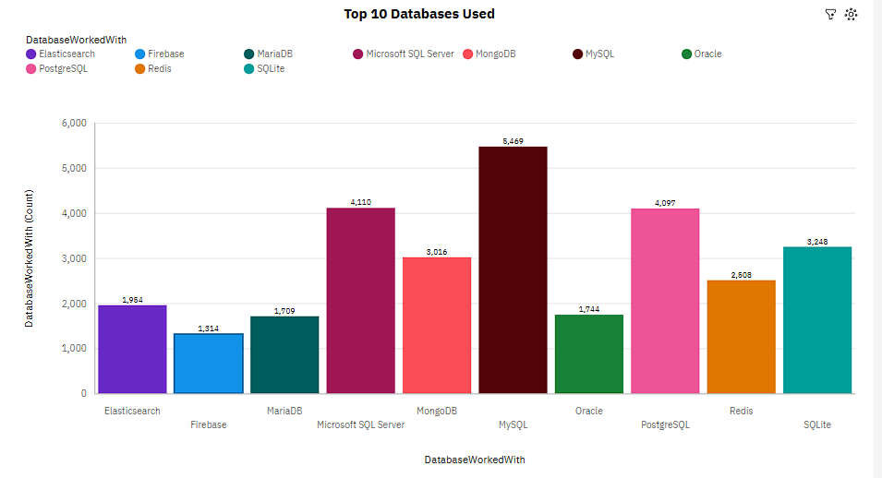
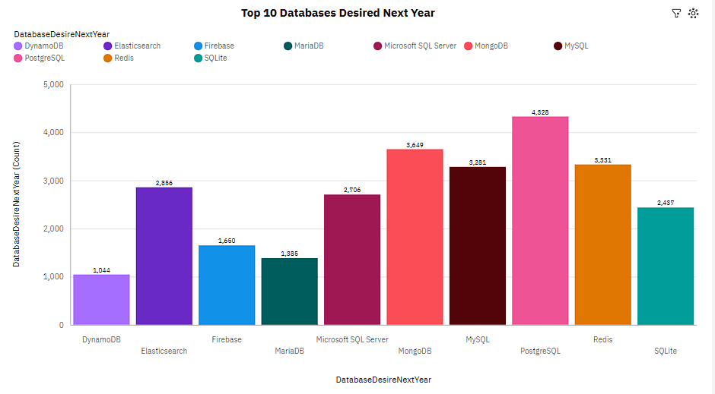
DATABASE TRENDS
Current Year
Next Year

Slide 11
DATABASE TRENDS - FINDINGS & IMPLICATIONS
Findings
Data volume growing exponentially (IoT, digital transactions)
Shift towards cloud-based database solutions
Increased focus on data security and compliance

Slide 12
DATABASE TRENDS - FINDINGS & IMPLICATIONS
Implications
Need for scalable database architectures
Importance of developing comprehensive cloud strategies
Requirement for robust security protocols and training

Slide 13

DASHBOARD
LINK :
IBM-Data-Analyst-capstone-project/IBM Cognos dashboard.pdf at main · affan14/IBM-Data-Analyst-capstone-project (github.com)

Slide 14
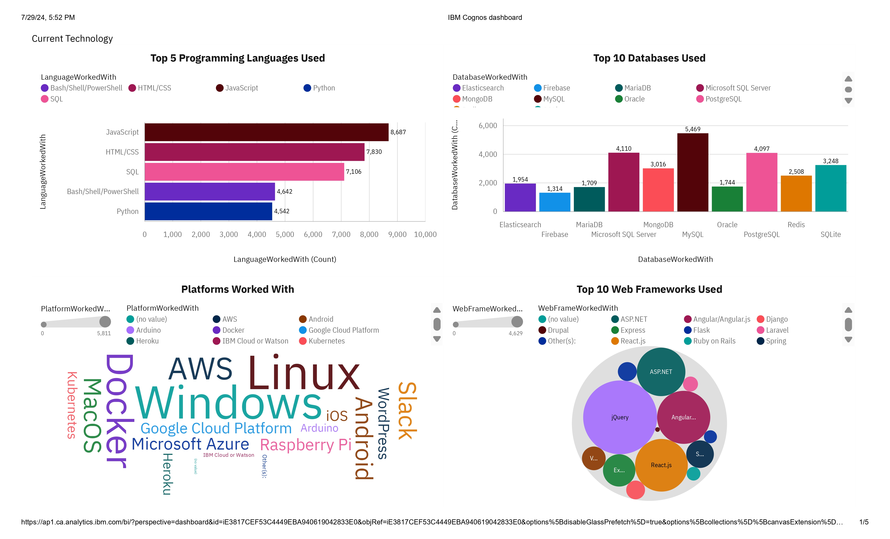
DASHBOARD TAB 1
Link - IBM-Data-Analyst-capstone-project/IBM Cognos dashboard.pdf at main · affan14/IBM-Data-Analyst-capstone-project (github.com)

Slide 15
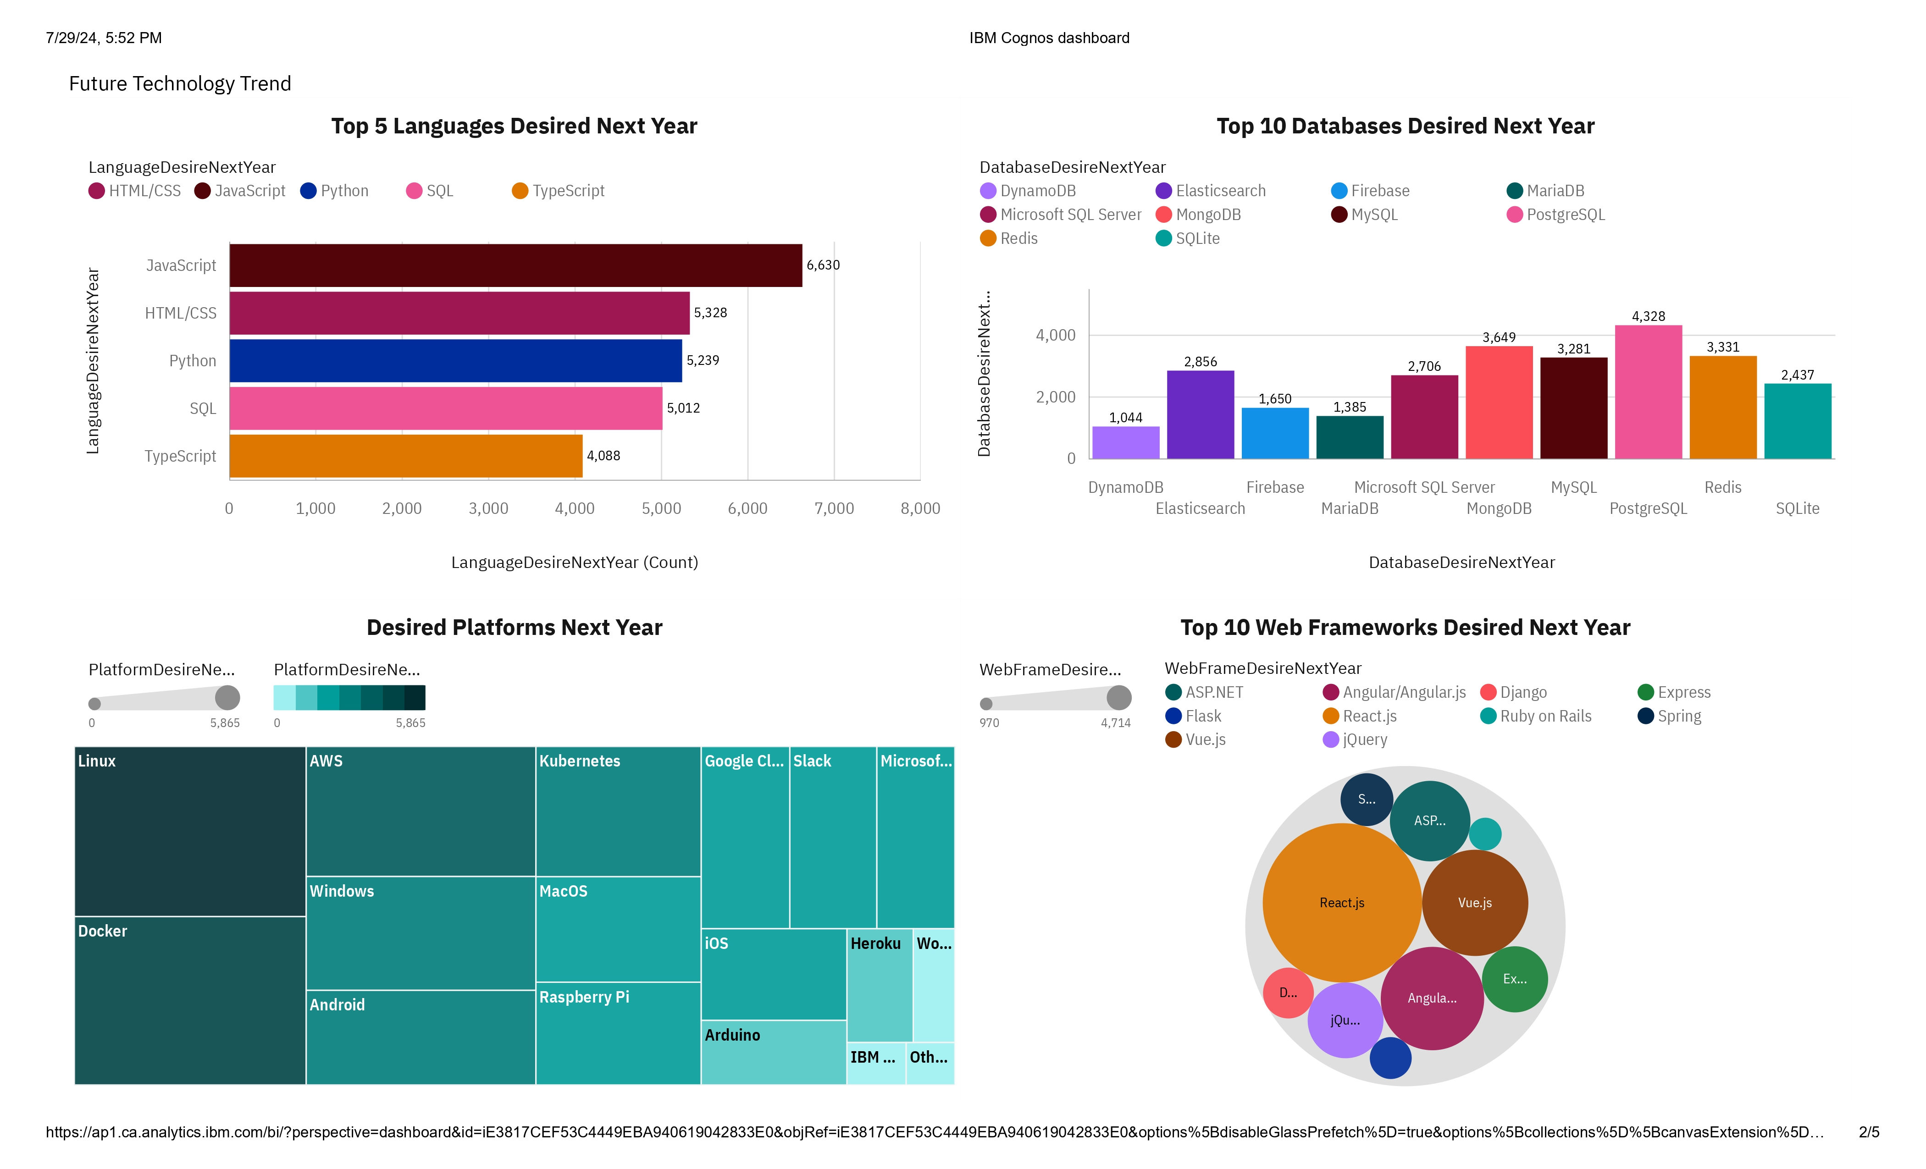
DASHBOARD TAB 2
Link - IBM-Data-Analyst-capstone-project/IBM Cognos dashboard.pdf at main · affan14/IBM-Data-Analyst-capstone-project (github.com)

Slide 16
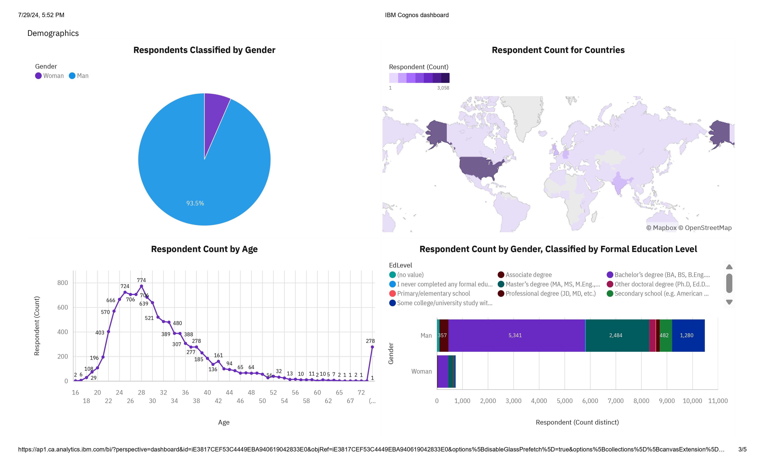
DASHBOARD TAB 3
Link - IBM-Data-Analyst-capstone-project/IBM Cognos dashboard.pdf at main · affan14/IBM-Data-Analyst-capstone-project (github.com)

Slide 17
DISCUSSION
1. Workforce: Young, male-dominated (93.5%), globally distributed, mostly bachelor's degree holders.
2. Current Tech: Python, JavaScript, MySQL, AWS, Docker, Linux, jQuery, React.js lead.
3. Emerging Trends: Growing interest in Python, MongoDB, Linux, AWS, React.js, Vue.js.
4. Direction: Shift towards diverse, modern, scalable, cloud-based, and interactive technologies.
Key Takeaway: The industry is evolving towards more diverse and modern technologies, with a focus on scalable, cloud-based solutions and interactive web frameworks.

Slide 18

OVERALL FINDINGS & IMPLICATIONS
Findings
1. Increasing Sales Trends:
Monthly sales are rising steadily.
Key metrics: total revenue, average order value, transactions.
2. Regional Sales Variations:
Significant differences in sales across regions.
Some regions consistently outperform others.
3. Customer Demographics:
Clear spending patterns linked to specific age groups.
Insights into customer behavior and preferences.

Slide 19

OVERALL FINDINGS & IMPLICATIONS
Implications
1. Focus on High-Performing Regions:
- Allocate more resources to top regions.
- Targeted marketing campaigns.
2. Tailor to Key Demographics:
- Customize products/services for high-spending age groups.
- Personalized marketing strategies.
3. Adjust Sales Strategies:
- Monitor trends and adjust as needed.
- Address underperforming areas with corrective actions.

Slide 20

CONCLUSION
Data-Driven Decision Making: Leverage dashboard insights for strategic planning and execution.
Customer-Centric Approach: Tailor offerings to high-value demographics and regions for maximum impact.
Continuous Improvement: Regularly review and adapt strategies based on performance metrics.
Growth Opportunities: Capitalize on successful regional strategies and explore expansion potential.

Slide 21

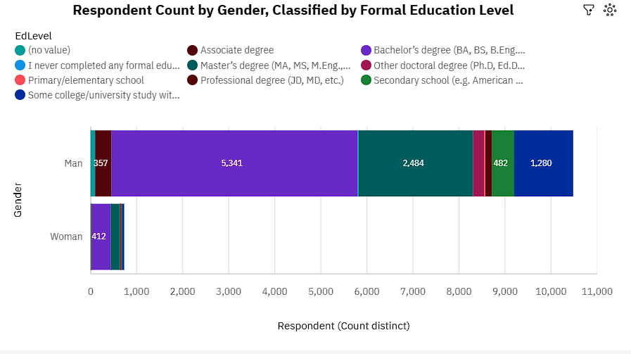
APPENDIX
Education Levels: Master's and Bachelor's degrees are the most common.
Gender Disparity: Significant male dominance in Master's and Bachelor's degrees.
Educational Attainment: High percentage of respondents with advanced degrees (over 70% with at least a Bachelor's).

Slide 22
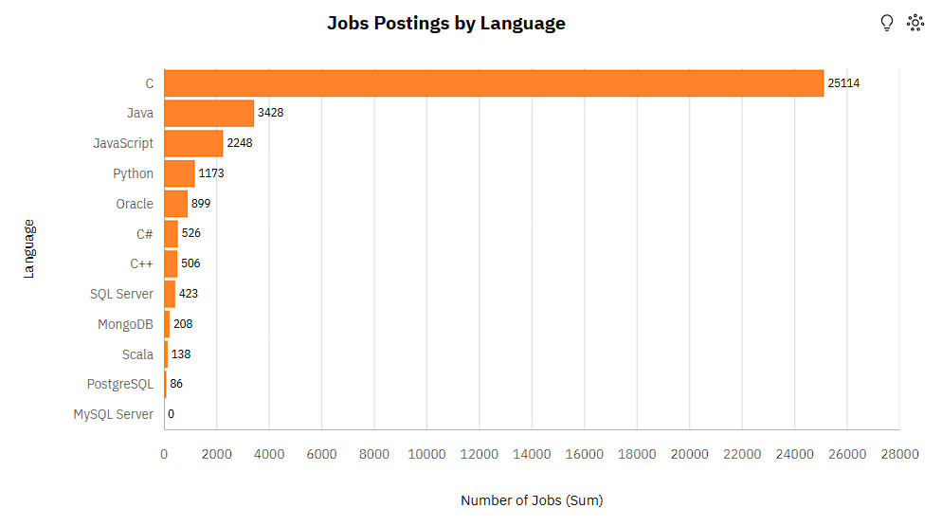
JOB POSTINGS
'C' has the highest number of job postings, indicating a high demand for C programmers.
Java and JavaScript follow 'C' with a substantial number of postings, showing strong demand in the market.
Python and Oracle have a moderate number of job postings, suggesting steady demand.
C#, C++, SQL Server, MongoDB, Scala, PostgreSQL, and MySQL Server have fewer job postings, indicating they are more specialized.

Slide 23
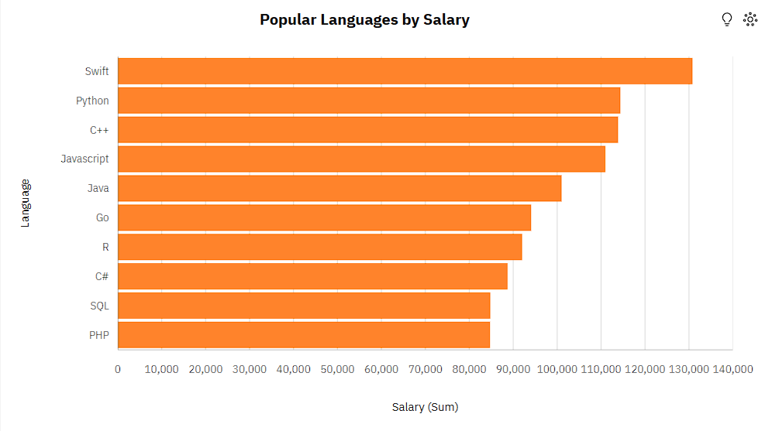
POPULAR LANGUAGES
Swift offers the highest average salary, making it a lucrative skill to have.
python and C++ also offer high salaries, indicating their strong market value.
JavaScript and Java provide competitive salaries, reflecting their importance in the industry.
Go, R, C#, SQL, and PHP offer good salaries, suggesting they are well-regarded but not at the top salary tier.

